Slide 1
Microsoft Clarity (Promact infotech Website)
Task PPT

Slide 2
Table of contents
01
Introduction
02
Research on Microsoft Clarity
03
Recommendation
Identified Key Features On Promact Website
04
Key Matrix Analysis
05
06
Conclusion

Slide 3
Analysis of User interaction on promact website using microsoft clarity
Name :Sawlani Kush
Date:13-02-2023
This is ppt includes Theoretical Observations based on the use cases of Microsoft Clarity on Promact Infotech Website.

Slide 4
01
Introduction
Next Slide Includes Intro Regarding Microsoft Clarity.

Slide 5
Introduction
This report presents an analysis of user interactions on the Promactinfo.com website utilizing Microsoft Clarity. Collected Data from Semrush.com and Similar Web and Promact Website defines profound Developer opportunities for all as it includes the company insights and Products as well info about Promact.

Slide 6
02
Research on Microsoft Clarity
Insights About Clarity

Slide 7
SOP analysis Of Clarity
S
O
The objective of Microsoft Clarity is to offer website
owners a comprehensive understanding of user behavior
on their websites. By providing detailed analytics through features like session recordings, heatmaps, and click tracking.
Microsoft Clarity's strength lies in its comprehensive analysis of user behavior on websites. Through session recordings, heatmaps, and click tracking, Clarity offers invaluable insights into how users interact with a website in real-time.
Strengths
Objective
Paying taxes in time
taxes in time
P
Purpose
Microsoft Clarity is a user-friendly analytics tool designed to provide website owners with actionable insights into user behavior. Through features like session recordings and heatmaps, Clarity helps businesses understand how visitors interact with their websites, allowing for informed decisions to improve user experience.

Slide 8
03
Identified Key Features On promact Website
Implement Clarity by dummy data on promactinfo website.

Slide 9
Website Features to integrate in Clarity
Services
Carrer Paths
Products
Life@Promact
Company
About us and Blog
->Product Engineering
->Mobile Devlopment
->Devops etc
Info about Team Size of 120+ People
->Questy
Apart from work we know how to enjoy life
->About us
->Carrer
->Life
->Internship
Subscribe to mailing list.

Slide 10
04
Key Matrix Analysis
Dummy Data Collected From SemRush

Slide 11
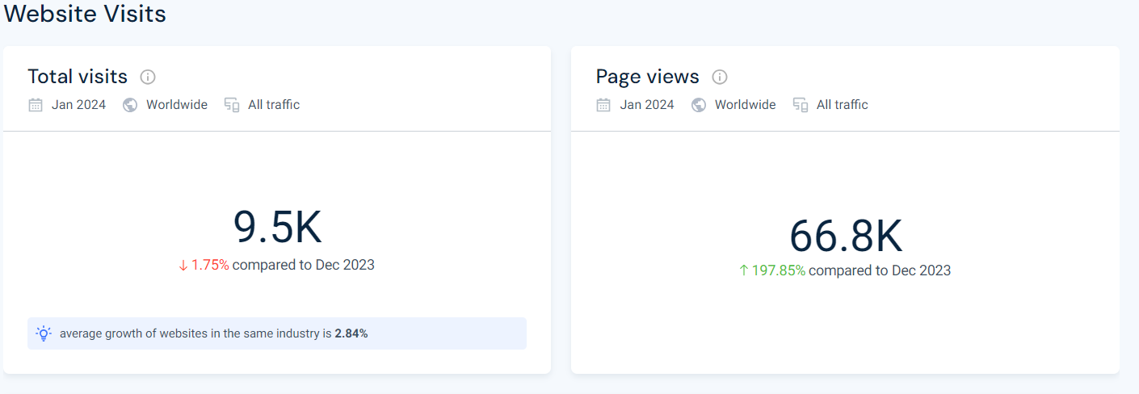
Key Traffic Analysis:-
1)Websites Visit And Page Views

Slide 12
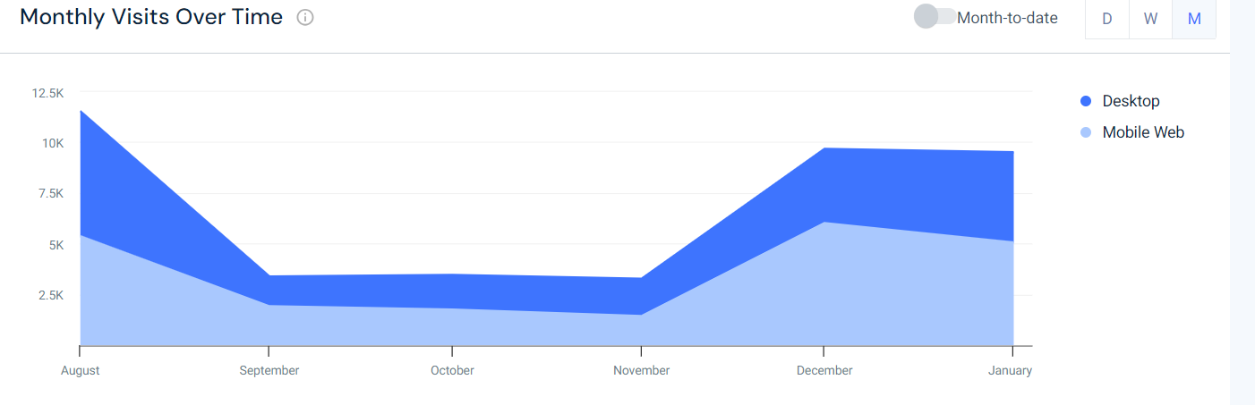
Monthly Visit:

Slide 13
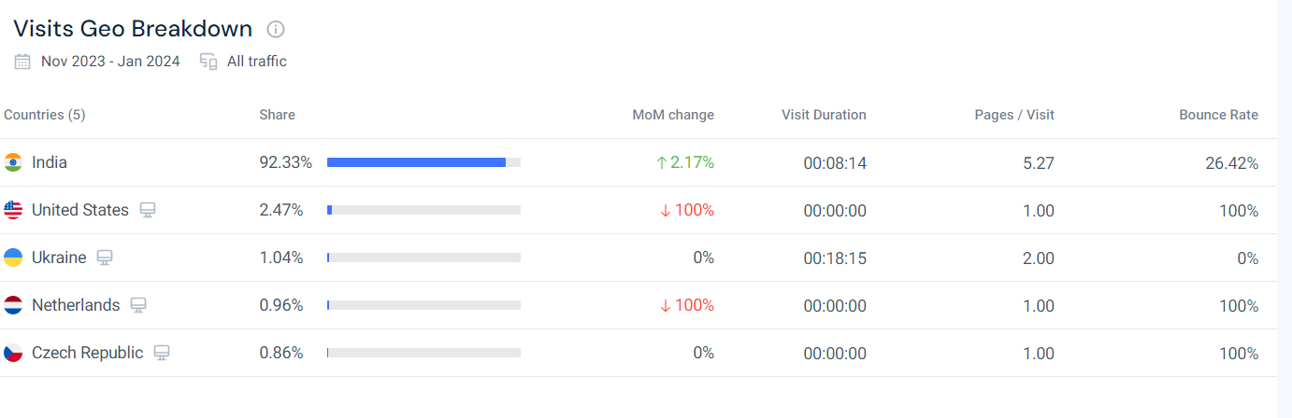
Visit Geo Breakdown:

Slide 14
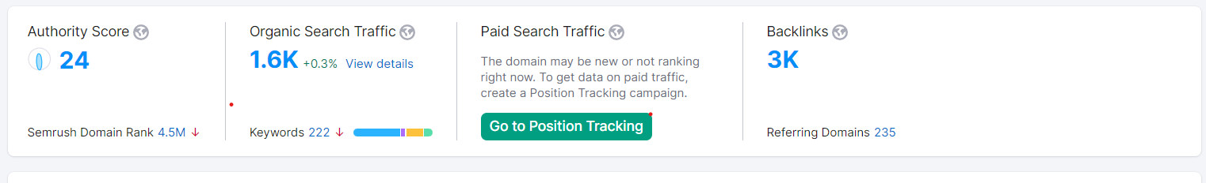
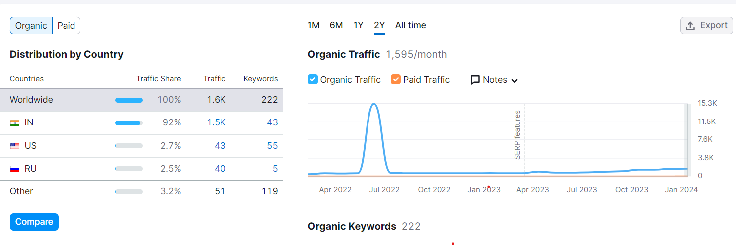
Research From Semrush :-
Organic Traffic :-

Slide 15
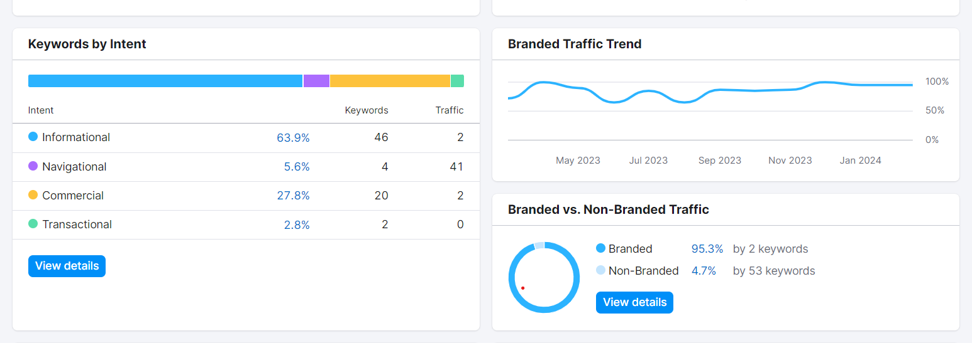
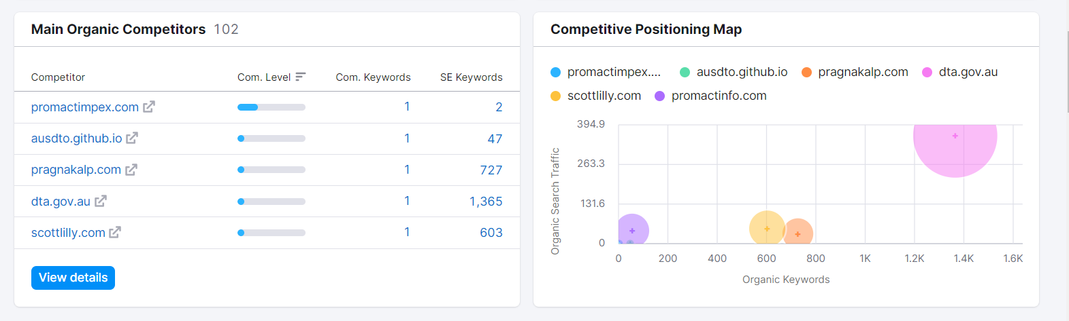
Keywords Intent :-
Traffic Postioning Map :-

Slide 16
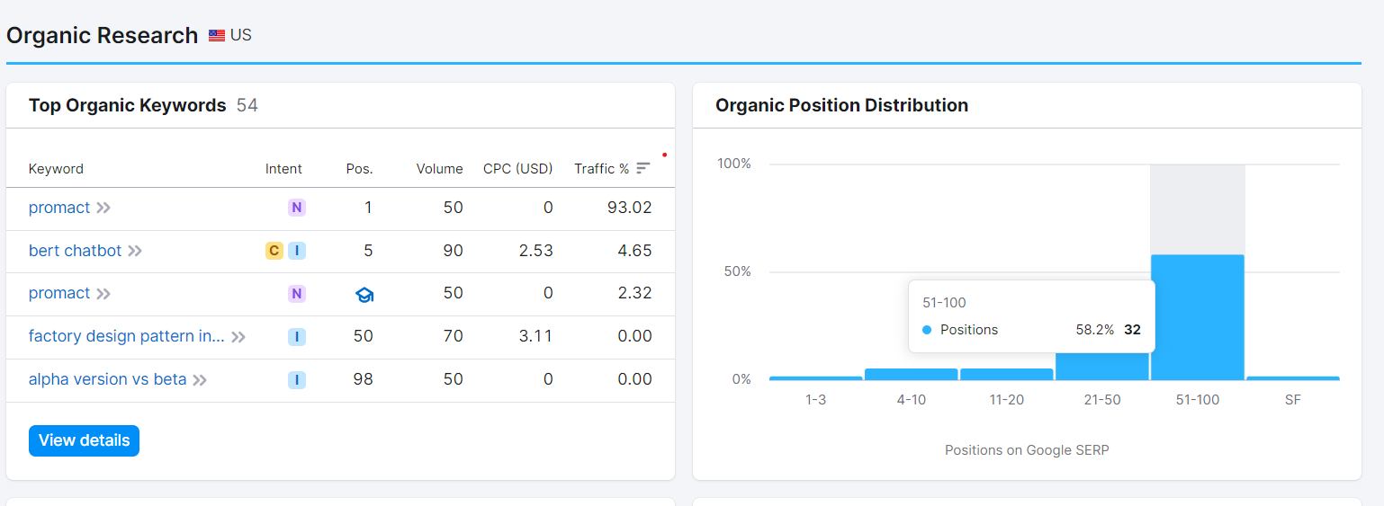
Organic Research:

Slide 17
05
Dummy Heatmaps Insight
Dummy Data Collected From SemRush

Slide 18
Dummy Heatmaps Insight:
1. Homepage:
- Header: High density of clicks on the navigation menu and logo.
- Hero Section: Moderate engagement with the call-to-action button "Learn More."
- Footer: Some clicks on social media icons and navigation links.
2. Services Page:
- Sidebar: Minimal interaction with sidebar elements.
- Main Content: Higher click density on service offerings and related links.
- Call-to-Action Buttons: Varied engagement with buttons like "Contact Us" and "Request a Quote."
3. Blog Post:
- Title: Moderate clicks on blog post titles, indicating interest.
- Content: Scrolling patterns show engagement with text and images.
- Comments Section: Some interaction with the comment submission form and social sharing buttons.
4. Contact Page:
- Contact Form: Clicks primarily focused on form fields and submission button.
- Map Widget: Clicks on the map to explore location details.
- Footer: Navigation links like "Privacy Policy" and "Terms of Service" receive some attention.
5. About Us Page:
- Team Section: Clicks on team member profiles and social media links.
- Mission Statement: Engagement with key messages and values.
- Awards/Recognition: Some interest in accolades and achievements.
.

Slide 19
06
Recommendation
Furthur Improvement in PromactInfo Website in Perspective of Microsoft Clarity.

Slide 20
Recommendation:
1. **User Engagement Analysis:** Utilize Clarity's session recordings and heatmaps to understand user interaction metrics like click-through rates and scroll depth.
2. **Conversion Funnel Optimization:** Use session recordings to identify and address any obstacles in the conversion process.
3. **Mobile Optimization:** Analyze device-specific data to ensure a seamless experience for mobile users.
4. **Content and CTA Optimization:** Optimize CTAs and content placement based on Clarity insights to maximize user engagement.
5. **Performance Optimization:** Improve website speed and responsiveness using Clarity's performance data.
6. **SEO Insights and Optimization:** Utilize Clarity to analyze user search behavior and optimize website content for better search engine visibility.
7. **Continuous Improvement:** Implement iterative improvements based on Clarity insights to enhance the overall user experience.
.

Slide 21
Conclusion
In conclusion, leveraging Microsoft Clarity provides invaluable insights into user behavior and website performance,
enabling informed optimization strategies. By analyzing user engagement, conversion funnels, and performance metrics, businesses can enhance the overall user experience, drive conversions, and improve search engine visibility. Continuous monitoring and iterative improvements based on Clarity insights ensure that the website remains optimized and
aligned with user preferences and industry best practices

